Slide 1


Unit – II

Slide 2
Arrays
An array is a collection of variables of the same type, referred to by a common name. An array organizes the data in such a way that it can be easily manipulated.

Slide 3
One dimensional Arrays
A one dimensional array is a list of related variables. It can be declared using following format:
type array-name[]=new type[size];
Here, type declares the element type of the array. The element type determines the data type of each element contained in the array. The number of elements that the array will hold is determined by size.

Slide 4
One dimensional Arrays
int sample[]=new int[10];
It is possible to break the declaration into two steps as follows:
int sample[];
sample=new int[10];

Slide 5
One dimensional Arrays
Individual elements can be accessed by the use of an index. An index describes the position of an element within an array. Array index starts from 0.

Slide 6
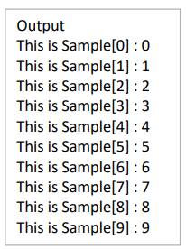
One dimensional Arrays
Example
//Demonstrate one dimensional array
class ArrayDemo {
public static void main(String args[]) {
int sample[]=new int[10];
int i;
for(i=0;i<10;i++)
sample[i]=i;
for(i=0;i<10;i++)
System.out.println(“This is Sample[ ”+i+“] :”+sample[i]); }
}

Slide 7
One dimensional Arrays
An array can be initialized at the time of creation. The general format is:
type array-name[] ={ val1, val2, val3, ....., valN}
Here, the initial values are specified by val1 through valN. They are assigned in sequence left to right in index order. Java automatically allocates an array large enough to hold the initializers. There is no need to explicitly use new operator.

Slide 8
One dimensional Arrays
Example: //Demonstrate Use of Array initializers
class Minimax {
public static void main(String args[]) {
int nums[]={ 99, 0, -10, 1023, 19, -99, 5678, 800, 784, -9 };
int min, max;
min=max=nums[0];
for(int i=1;i<10;i++) {
if(max<nums[i])
max=nums[i];
if(min>num[i])
min=num[i]; }
System.out.println(“Min and Max : ” +min +” “ +max);
}
}

Slide 9
Two dimensional Arrays
Simplest form of multi-dimensional array is two dimensional array. It can be declared as follows:
int table[][]=new int[10][10];

Slide 10
Two dimensional Arrays
Example: //Demonstrate two dimensional array
public class TwoDimensionalArrayExample {
public static void main(String[] args) {
int[][] twoDArray = { {1, 2, 3, 4}, {5, 6, 7, 8}, {9, 10, 11, 12} }; System.out.println("Elements of the 2D array:");
for (int i = 0; i < twoDArray.length; i++) {
for (int j = 0; j < twoDArray[i].length; j++) { System.out.print(twoDArray[i][j] + " ");
}
System.out.println();
}
twoDArray[1][2] = 99;
System.out.println("\nModified element:"); System.out.println("twoDArray[1][2] = " + twoDArray[1][2]); } }

Slide 11
Two dimensional Arrays
Irregular Arrays
When allocating memory for a multidimensional array, only the memory for the leftmost dimension needs to be specified. The remaining dimensions can be allocated separately. We need not allocate the same number of elements for each index. The length of each array can be controlled by the programmer.

Slide 12
Two dimensional Arrays
Irregular Arrays
public class IrregularArrayExample {
public static void main(String[] args) {
int[][] irregularArray = new int[3][];
irregularArray[0] = new int[]{1, 2, 3};
irregularArray[1] = new int[]{4, 5, 6, 7};
irregularArray[2] = new int[]{8, 9}; System.out.println("Elements of the irregular array:");
for (int i = 0; i < irregularArray.length; i++) {
for (int j = 0; j < irregularArray[i].length; j++) { System.out.print(irregularArray[i][j] + " "); } System.out.println();
}
} }

Slide 13
Arrays of three more directions
Java allows arrays with three or more dimensions. The general format is:
type name[][][] .....[]=new type[size1][size2].......[sizeN];
Example: int muldim[][][]=new int[4][10][3];

Slide 14
Assigning Array references
When one array reference variable is assigned to other, we are changing what object that variable refers to.

Slide 15
Assigning Array references
classArrRef {
public static void main(String args[]) {
int i;
int num1[]=new int[10];
int num2[]=new int[10];
for (i=0;i<10;i++)
num1[i]=i;
for (i=0;i<10;i++)
num2[i]= -i;
System.out.print(“Here is num1 :”);
for (i=0;i<10;i++)
System.out.print (num1[i] + “ ”);
System.out.println();
System.out.print(“Here is num2: ”);
for (i=0;i<10;i++)
System.out.print (num2[i] + “ ”);
System.out.println();
num2=num1;
System.out.println(“num2 after change”);
for (i=0;i<10;i++)
System.out.print (num2[i] + “ ”);
System.out.println();
num2[3]=-99;
System.out.println(“num2 after change”);
for (i=0;i<10;i++)
System.out.print (num2[i] + “ ” );
} }

Slide 16
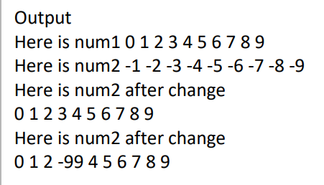
Assigning Array references

Slide 17
Using Length Member
Because, arrays are implemented as objects, the length instance variable associate with each array contains the number of elements that the array can hold.
Example: //Demonstrate Array Length
class LengthDemo {
public static void main(String args[]) {
int list[]={ 1, 0, 99, 8, -7, 74};
for(int i=0; i<list.length;i++)
System.out.print(list[i] + “ ”)
}
}

Slide 18
The For – Each Style for loop
When working with arrays, it is common to encounter situations in which each element in an array must be examined from start to finish. Java defines a second form of for loop that streamlines this operation. This form is “for-each” style loop. It cycles through an array in a strictly sequential manner from start to finish. The general form of this loop is :

Slide 19
The For – Each Style for loop
for(type itr-var : collection)
statement-block;
Here, type specifies the type, and itr-var specifies the name of the iteration variable that will receive the elements from a collection, one at a time, from beginning to end. With each iteration of the loop, the next element in the collection is retrieved and stored in itr-var. The loop repeats until all the elements in the collection are obtained.

Slide 20
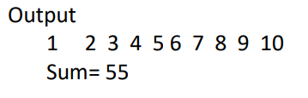
The For – Each Style for loop
Example:
class ForEach {
public static void main(String args[]) {
int list[]={1,2,3,4,5,6,7,8,9,10};
int sum=0;
for(int x:list) {
System.out.print(x + " ");
sum+=x; }
System.out.println("\n Sum= "+sum);
} }

Slide 21
Strings
In Java, strings are objects. The syntax for creating strings is given below:
String str = new String(“Hello”);
String str2 = new String(str);

Slide 22
String operations
boolean equals(str) | Returns true if the invoking string contains same character sequence as str
int length() | Obtains the length of the string
char charAt(index) | Obtains the character at specified index
int compareTo(str) | Returns less than zero if the invoking string is less than str, greater than zero if the invoking string is greater than str and zero if the strings are equal
int indexOf(str) | Searches the invoking string for the substring specified by str. Returns the index of the first match or -1 on failure
int lastIndexOf(str) | Searches the invoking string for the substring specified by str. Returns the index of the last match or -1 on failure

Slide 23
Open PDF for example (5th Page)

Slide 24
Using Command Line Argument
In certain cases, we may need to provide inputs at the time of execution. This is achieved in Java by using command line arguments. Command line arguments are parameters that are supplied to a program at the time of execution.

Slide 25
Using Command Line Argument
public class CommandLineArgumentsExample {
public static void main(String[] args) {
if (args.length == 0) {
System.out.println("No command-line arguments provided."); } else {
System.out.println("Number of command-line arguments: " + args.length); System.out.println("Command-line arguments:");
for (int i = 0; i < args.length; i++) {
System.out.println((i + 1) + ": " + args[i]);
} } } }

Slide 26
Using Command Line Argument
javac CommandLineArgumentsExample.java
java CommandLineArgumentsExample arg1 arg2 arg3

Slide 27
Classes Objects and Methods
Java is a true Object-Oriented language and therefore the underlying structure of all Java programs is classes.
Anything we wish to represent in a Java program must be encapsulated in a class.
In Java, the data items are called fields and the functions are called methods.

Slide 28
Classes Objects and Methods
A class is a user-defined data type with a template that serves to define its properties. Once the class type has been defined, we can create ‘variables’.
In Java, these variables are termed as instances of classes.
Java classes consist of both attributes and behaviors. Attributes represent the data that is unique to an instance of a class, while behaviors are methods that operate on the data to perform useful tasks.

Slide 29
Classes Objects and Methods
A class is created by using the keyword class. The general form is as follows:
class classname {
type var1;
type var2; ......
type var n;
return-type method-name-1(arguments) {
body of the method ; }
return-type method-name-2(arguments) {
body of the method ; } ......
return-type method-name-n(arguments) {
body of the method ; } }

Slide 30
Classes Objects and Methods
The class with only data fields has no life. The objects created by such a class cannot respond to any message. Methods are necessary for manipulating data contained in a class. Methods are declared inside the body of the class after declaring instance variables. Method declaration should have return type, method name list of parameters and body. The method name main() is reserved. A method contains one or more Java statements but performs only one task.

Slide 31
Creating Objects
An object in Java is essentially a block of memory that contains space to store all the instance variables. Creating an object is also referred to as instantiating an object.
Objects in Java are created using the new operator. The new operator creates an object of the specified class.

Slide 32
Creating Objects
Example:
Rectangle rect1;
rect1= new Rectangle();
Both statements can be combined in to a single statement as follows:
Rectangle rect1= new Rectangle();
The method Rectangle() is the default constructor of the class. We can created any number of objects of type Rectangle.

Slide 33
Creating Objects
Accessing Class Members
The variables and methods inside a class can be accessed from outside using dot operator. The format is as shown below:
objectname.variablename;
objectname.methodname(parameter-list);

Slide 34
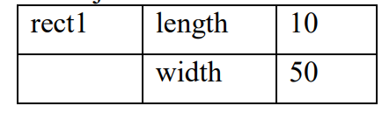
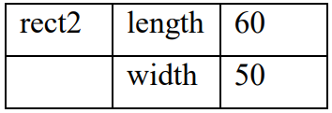
Creating Objects
Example:
rect1.length=10;
rect1.width=50;
rect2.lenght=60;
rect2.width=50;
The two objects rect1 and rect2 store different values as shown below:

Slide 35
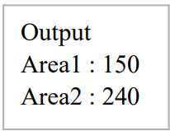
class Rectangle {
int length, width;
void getData(int x, int y) {
length=x;
width=y;
}
int rectArea() {
int area=length *width;
return(area);
}
}
class RectArea {
public static void main(String args[]) {
int area1, area2;
Rectangle rect1 = new Rectangle();
Rectangle rect2 = new Rectangle();
rect1.lenght = 15;
rect1.width=10;
area1 = rect1.lenght * rect1.widht;
rect2.getData(20, 12);
area2=rect2.rectArea();
System.out.println(“Area1 : ” +area1); System.out.println(“Area2 : ” +area2);
}
}

Slide 36
Constructors
In order to be used by a program, an object must first be instantiated from its class definition. A special type of method called a constructor is used to define how objects are created. Constructors are special methods which have same name as that of class. They do not specify return type, not even void. This is because they return the instance of the class itself.

Slide 37
Constructors
class Rectangle {
int length, width;
Rectangle(int x, int y) {
width=y;
length=x; }
int rectArea() {
int area=length *width;
return(area);
}
}
class rectArea {
public static void main(String args[]) {
Rectangle rect1 = new Rectangle(15, 10);
int area= rect1.rectArea();
System.out.println(“Area : ” +area);
}
}

Slide 38
Garbage Collections and Finalizers
Java dynamically allocates objects from a pool of free memory using the `new` operator.
Memory allocation can fail if there's insufficient free memory.
Garbage collection is essential for reclaiming memory from unused objects.
Garbage collection in Java automatically reclaims memory when no references to an object exist.
Reclaimed memory can be reused for subsequent allocations.
Garbage collection typically occurs when there are objects to recycle and a need to recycle them.

Slide 39
Garbage Collections and Finalizers
The finalize() method
It is possible to define a method that will be called just before an object’s final destruction by the garbage collector. This method is called finalize() method and it can be used to make sure that an object terminates cleanly. Syntax of adding a finalize() method is given below:
protected void finalize() {
// Finalization code will be written here
}

Slide 40
Garbage Collections and Finalizers
class Finalize {
public static void main(String args[]) {
int count;
FDemo ob = new FDemo(0);
for (count=1; count < 100000; count++)
ob.generator(count);
ob.finalize();
} }
Example:
class FDemo {
int x;
FDemo(int i) {
x=i;
}
protected void finalize() {
System.out.println(“ Finalizing ” +x);
}
void generator(int i) {
FDemo ob= new FDemo(i);
System.out.println("Printing " +i);
} }

Slide 41
Garbage Collections and Finalizers
The this keyword
When a method is called, it is automatically passed an implicit argument that is a reference to the invoking object. This reference is called as this. Java syntax permits the name of the parameter or the local variable to be the same as the instance variable. When this happens, the local variable hides instance variable. The instance variable can be accessed by referring it through this keyword.

Slide 42
Garbage Collections and Finalizers
Open PDF for example of this (10th Page)

Slide 43
Controlling Access to Class Members
In its support for encapsulation, the class provides two major benefits. First, it links data with code that manipulates it. Second, it provides means by which access to members can be controlled. Restricting access to members of a class is a fundamental part of object-oriented programming as helps prevents the misuse of an object. By allowing access to data only through a well-defined set of methods, it is not possible for code outside the class to access and modify values of members directly.

Slide 44
Java’s Access Modifiers
The member access control is achieved through the use of three access modifiers: public, private and protected.
Protected will be applied only in case of inheritance.
When a member of a class is modified public specifier, that member can be accessed by any other code in the program.
When a member of a class is specified as private, that member can be accessed only by any other members in its class.
The default access specifier is public. Access modifier precedes the rest of the type specification.

Slide 45
Java’s Access Modifiers
public:
Any variable or method is visible to the entire class in which it is defined. We can make it visible to all the classes outside the class by simply declaring the variable or method as public. The variable or method declared as public has the widest possible visibility and accessible everywhere.
Ex : public int number;
public void sum()
{ ….. }

Slide 46
Java’s Access Modifiers
friendly:
When no access modifier is specified, the member defaults to a limited version of public visibility known as friendly(default) level of access. The difference between the ‘public access’ and the ‘friendly access’ is that the public modifier makes fields visible in all classes, regardless of their packages while the friendly access makes fields only in the same package, but not in other packages. A package is a group of related classes stored separately.

Slide 47
Java’s Access Modifiers
protected:
The visibility level of protected field lies in between the public access and friendly access. That is, the ‘protected’ modifiers makes the fields visible not only to all classes and subclasses in the same package but also to subclasses in other packages. Note that non-subclasses in other packages cannot access the ‘protected’ members.

Slide 48
Java’s Access Modifiers
private:
private fields enjoy the highest degree of protection. They are accessible only within their own class. They cannot be inherited by subclasses and therefore not accessible in subclasses. A method declared as private behaves like a method declared as final. It prevents the method from being subclasses. Also note that we cannot override a non-private method in a subclass and then make it private.

Slide 49
Java’s Access Modifiers
private protected:
This gives visibility level in between ‘protected’ access and ‘private’ access. This modifier makes the fields visible in all subclasses regardless of what package they are in. Remember, these fields are not accessible by other classes in the same package.

Slide 50
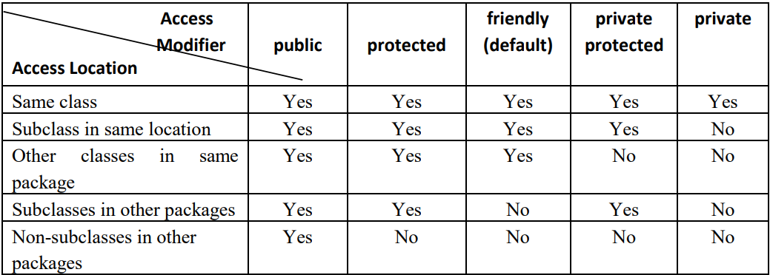
Java’s Access Modifiers

Slide 51
Java’s Access Modifiers
Open PDF for example (13th Page)

Slide 52
Pass Objects to Methods
Open PDF for example (13th Page)

Slide 53
Pass – by Value and Pass – by Reference
The actual arguments are those stated in the calling function. Formal parameters, on the other hand, are those that are defined in the called function.

Slide 54
Pass – by Value and Pass – by Reference
Call by value or pass by value approach copies the vaue of an argument into the formal parameter of the subroutine. Therefore changes made to the parameter have no effect. When arguments are passed as primitive data types, the method is pass-by value.

Slide 55
Pass – by Value and Pass – by Reference
Open PDF for example (14th Page)

Slide 56
Pass – by Value and Pass – by Reference
Open PDF for example (15th Page)
Pass by reference

Slide 57
Returning Objects
Open PDF for example (15th Page)

Slide 58
Overloading Methods
Two methods with the same name but different signatures lead to method overloading.
Method overloading can occur within a class or through inheritance.
In Java, methods can have identical names but different parameter lists and definitions.
Method overloading is used when objects are required to perform similar tasks with different input parameters.
Java determines which method definition to execute based on matching the method name and parameter types. This process is known as polymorphism.

Slide 59
Overloading Methods
Open PDF for example (16th Page)

Slide 60
Automatic Type Conversion in Overloading Methods
Open PDF for example (17th Page)

Slide 61
Overloading Constructors
In addition to overloading normal methods, we can also overload constructor methods.
Open PDF for example (18th Page)

Slide 62
Overloading Constructors
In addition to overloading normal methods, we can also overload constructor methods.
MyClass() is overloaded four ways, each constructing an object differently. The proper constructor is based upon the parameters specified when new is executed.
Open PDF for example (18th Page)

Slide 63
Recursion
In Java, a method can call itself. This process is called recursion and a method that calls itself is said to be recursive.
Open PDF for example (19th Page)

Slide 64
Understanding Static
They are declared using the `static` keyword and can be methods or variables.
Static members can be accessed using the class name, not requiring an instance of the class.
Open PDF for example (20th Page)

Slide 65
Static Methods
Methods declared as static have several restrictions:
They can directly call only other static methods.
They can directly access only static data.
They do not have a this reference.
The difference between the static method and a normal method is that the static method is called through its class name, without any object of that class being created.
Open PDF for example (21th Page)

Slide 66
Static Block
Static blocks are needed to initialize static variables before any of the static methods of a class are used. A static block is executed when the class is first loaded. Thus, it is executed before the class can be used for any other purpose.
Open PDF for example (21th Page)

Slide 67
Nested and Inner Classes
Nested class is a class that is declared within another class. A nested does not exist independently of its enclosing class. Thus the scope of a nested class is bounded by its outer class. It has access to all the variables and methods of its outer class.
Open PDF for example (22nd Page)

Slide 68
/
Varargs: Variable Length Arguments
Sometimes it may be necessary to create a method that takes a variable number of arguments. This can be handled in two ways. If the maximum number of arguments is small and known, the methods can be overloaded. If the maximum number of arguments is large and unknown, we can construct a method that takes variable number of arguments.
A variable-length argument is specified by three periods (…)
Open PDF for example (23rd Page)

Slide 69
Inheritance
Inheritance is one of the basic principles of object-oriented programming.
A class that is inherited by is called superclass.
The class that does the inheritance is called subclass.
It inherits all the variables and methods defined by the superclass and adds its own unique elements.
Java supports inheritance by using the keyword extends.

Slide 70
Inheritance
The general form of a class declaration that inherits a superclass is given below:
class subclass-name extends superclass-name {
// body of the class
}
Open PDF for example (23rd Page)

Slide 71
Inheritance
Member Access and Inheritance
All the public members of the base class are inherited by the derived classes where as the members declared with the modifier private cannot be accessed by the derived class. The following example program will not be compiled.
Open PDF for example (24th Page)

Slide 72
Inheritance
Constructor and Inheritance
Both superclasses and subclasses can have their own constructors. The constructor of the superclass constructs the superclass portion of the object and that of the subclass constructs the subclass part.
Open PDF for example (24th Page)

Slide 73
Inheritance
Use of Super()
When both superclass and subclass define constructors, the process is bit complicated. The subclass constructor uses the keyword super to invoke the constructor of the superclass. The keyword super can be used only within the derived class and if included, it must always be the first statement executed inside a subclass constructor.
Open PDF for example (25th Page)

Slide 74
Inheritance
Using super to Access Superclass Members
We can access the superclass member with the help of super key word. This has the following form:
super.member
Open PDF for example (26th Page)

Slide 75
Inheritance
Multilevel Inheritance
It is possible to build hierarchies that contain many layers of inheritance. This phenomenon is called multilevel inheritance. In this situation there will be two or more levels of inheritance. If there are classes A B and C, in such a way that B is the subclass of A and C is the subclass of B we call it as multilevel inheritance.
Open PDF for example (29th Page)

Slide 76
Inheritance
Method Overriding
In a class hierarchy when a method in a subclass has the same return type and signature as a method in it’s superclass, then the method in the subclass is said to override the method in the superclass. when a overridden method is called from within a subclass, it will always refer to the version of that method defined by the subclass. The version of the method defined by the superclass will be hidden.
Open PDF for example (27th Page)

Slide 77
Inheritance
Final variables and methods
All methods and variables can be overridden by the subclasses. If we wish to prevent overriding the members if superclass we can declare them as final using the keyword final as modifier.
Example
final int size = 100;
final void showStatus();

Slide 78
Inheritance
Final variables and methods
class A {
final void meth() {
System.out.println(“This is a final method”);
} }
Class B extends A {
void meth() {
// Error can’t override!!!
} }

Slide 79
Inheritance
Abstract Methods and Classes
If we modify a method as final we ensure that the method is not redefined in a subclass. Java allows us to do something that is exactly opposite to this. That is, we can indicate a method must always be redefined in a subclass, thus making overriding compulsory. This is done using the modifier keyword abstract.
Example: abstract class Shape {
........ ........
abstract void show()
{ ........ }

Slide 80
Inheritance
Abstract Methods and Classes
While using abstract classes, we must satisfy the following conditions:
Abstract classes cannot be used to instantiate objects directly. For example: Shape s1=new Shape() is illegal because Shape is an abstract class according to the above example.
The abstract methods of an abstract class must be redefined in its subclass.
We cannot declare abstract constructors or abstract static methods.
Open ChatGPT for Example

